Slide 1
Project 308

Slide 2
Data Processing
Number of issues : 1000 ( without pre-processing )
After pre-processing : 647 ( Considering the issues which only have assignees )

Slide 3
Example Issue
"assignee": {
"self": "https://issues.apache.org/jira/rest/api/2/user?username=Jack-Lee",
"name": "Jack-Lee",
"key": "jack-lee", }
"summary": "Upgrade Jackson2 to the latest version",
"description": "Now Jackson 2.9.5 is used and it is vulnerable (CVE-2018-11307). Let's upgrade to 2.9.6 or upper.",

Slide 4
Thinking of taking top something coders to make ouer data statistically significant.
Text : Summary + Description
Coders will act like the classes in our model
Initial Objective : To classify the issues using textual information and find relevance with the coders

Slide 5
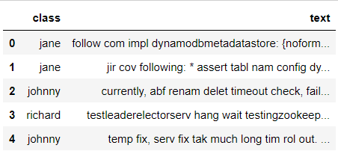
Data in the form of DataFrame

Slide 6
Basic NLP preprocessing
Vocabulary: {'one': 9, 'geek': 3, 'helps': 7, 'two': 11, 'geeks': 4, 'help': 6, 'four': 2, 'each': 1, 'many': 8, 'other': 10, 'at': 0, 'geeksforgeeks': 5}
Vocabulary: {'one': 9, 'geek': 3, 'helps': 7, 'two': 11, 'geeks': 4, 'help': 6, 'four': 2, 'each': 1, 'many': 8, 'other': 10, 'at': 0, 'geeksforgeeks': 5}
from sklearn.feature_extraction.text import CountVectorizer
document = ["One Geek helps Two Geeks",
"Two Geeks help Four Geeks",
"Each Geek helps many other Geeks at GeeksforGeeks"]
# Create a Vectorizer Object
vectorizer = CountVectorizer()
vectorizer.fit(document)
# Encode the Document
vector = vectorizer.transform(document)

Slide 7
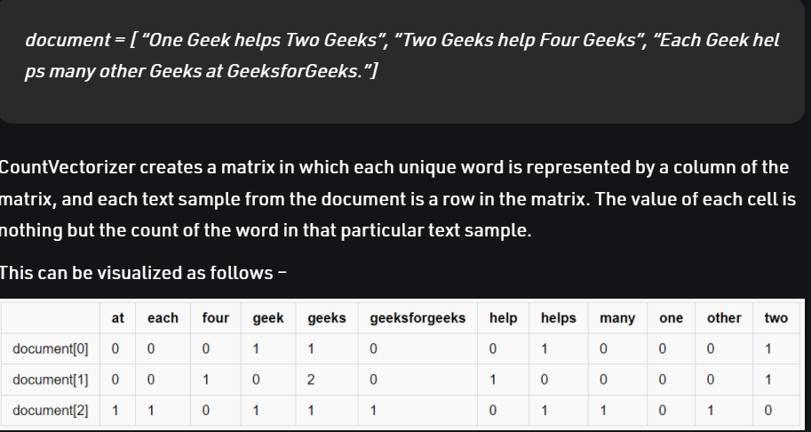
Vocabulary: {'one': 9, 'geek': 3, 'helps': 7, 'two': 11, 'geeks': 4, 'help': 6, 'four': 2, 'each': 1, 'many': 8, 'other': 10, 'at': 0, 'geeksforgeeks': 5}

Slide 8
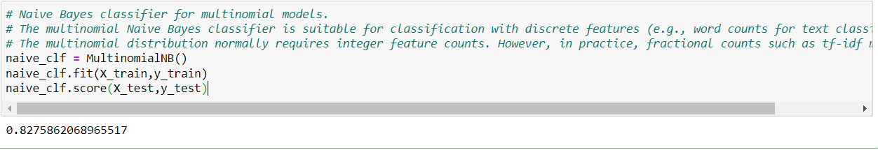
Applying Naïve Bayes Classifier to the data
Naive Bayes classifier for multinomial models

Slide 9
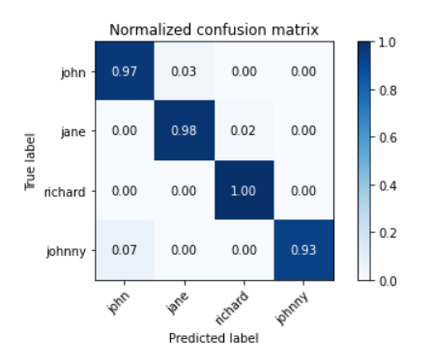
Predicted Result on the Training Set

Slide 10
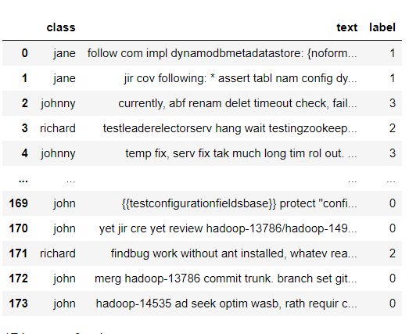
Sample Dataset

Slide 11
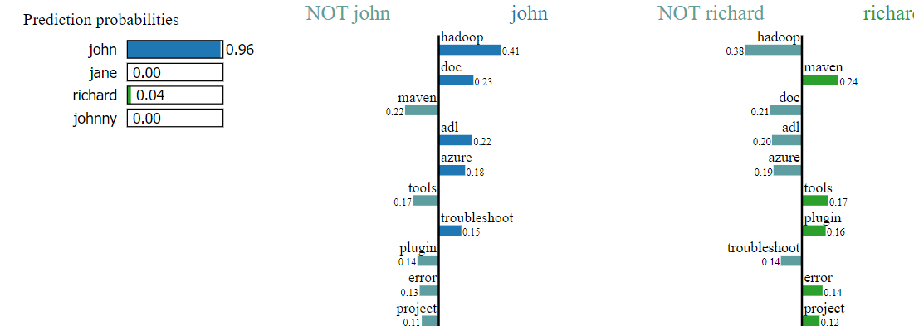
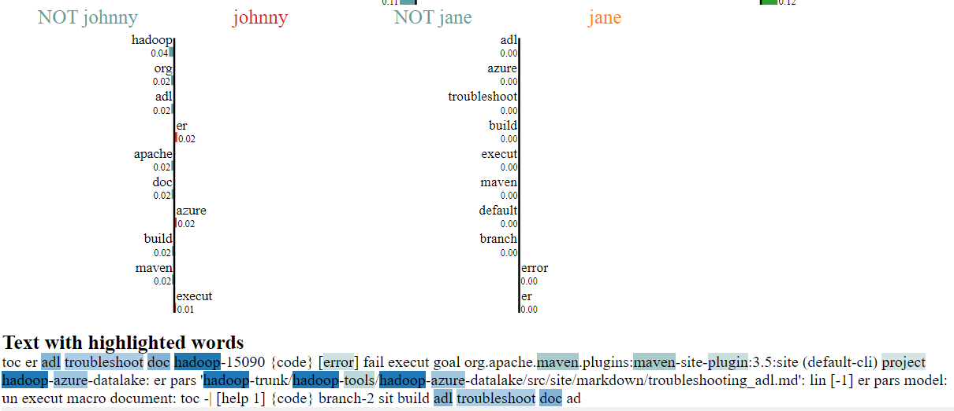
Example Issues 138
Text Input :

Slide 12
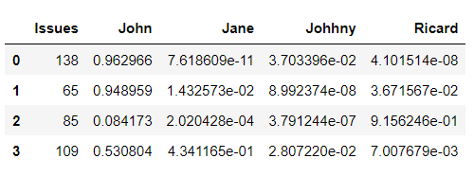
Relevance Matrix Using our Model

Slide 13
Problem Statement
At a current time we have:
Issues Available Workers
138 Jane
65 Ricard
85 Johnny
109 John

Slide 14
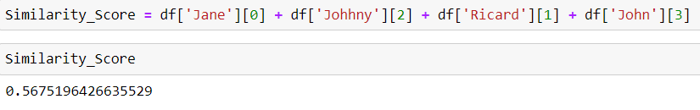
Formulation of our Problem Statement
Primary Model : Maximise this Relevance Score using OR optimisation tool
For example : Let our assignment be
138 – Jane
- John
85 – Johnny
109 – Ricard

Slide 15
